Slide 1
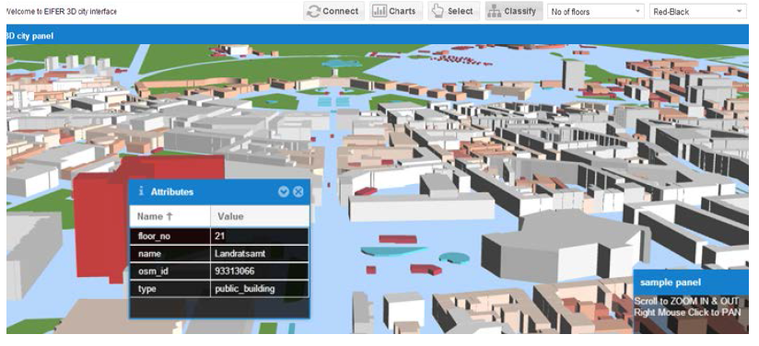
Jochen Wendel, Syed Monjur Murshed, Akila Sriramulu* and Alexandru Nichersu
European Institute for Energy Research, Karlsruhe Institute of Technology (KIT) & EDF
*Karlsruhe University of Applied Sciences, Karlsruhe, Germany
Development of a Web-Browser Based
Interface for 3D Data Visualisation
An open-source and plug-in free approach

Slide 2
Outline
Visualization needs for energy modelling
Data and technology requirements
Current status and limitations
3D visualization interface
Conclusion

Slide 3
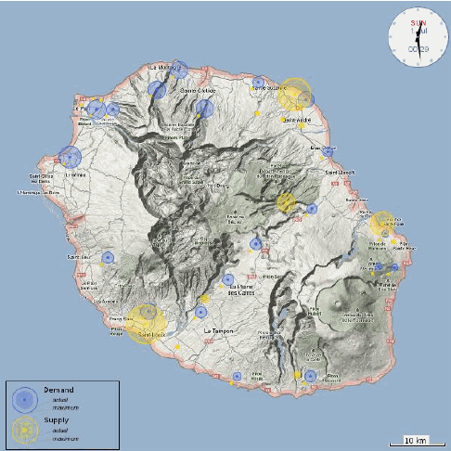
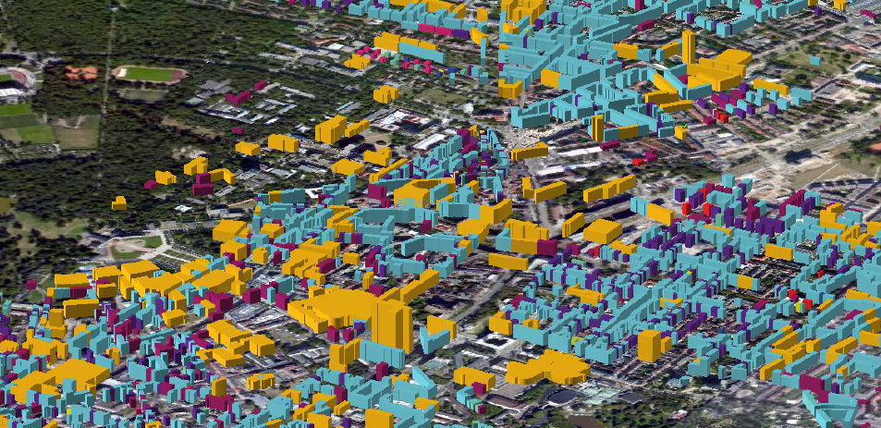
Energy modelling
Frameworks for energy modelling
Simulation modelling
Systems modelling (e.g. complex systems)
Energy and environment
Energy and urban systems
Building modelling
Notes:
Visualization of urban energy modelling and simulation results is a crucial part in energy research

Slide 4
Visualization needs
Scale dependence
2D
Global systems modelling
State wide modelling
Regional modelling
City modelling
District modelling
Building Simulation
3D
Notes:
Geospatial – Cartesian coordinate system

Slide 5
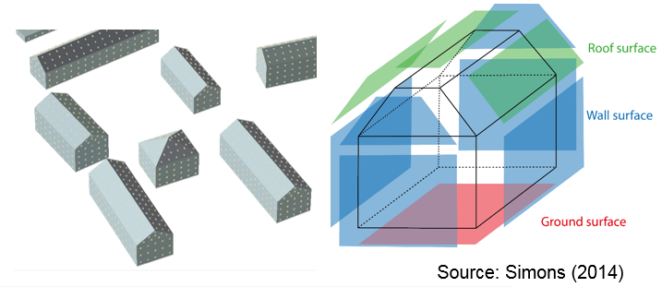
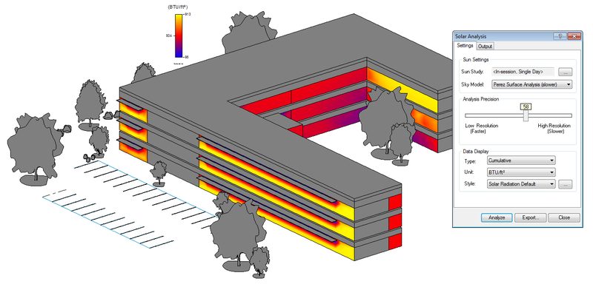
Visualization needs
Scale dependence
2D
Global systems modelling
State wide modelling
Regional modelling
(Simons and Nichersu 2014)
City modelling
District modelling
Building Simulation
3D
(Avsatthi 2015)
Notes:
Geospatial – Cartesian coordinate system

Slide 6
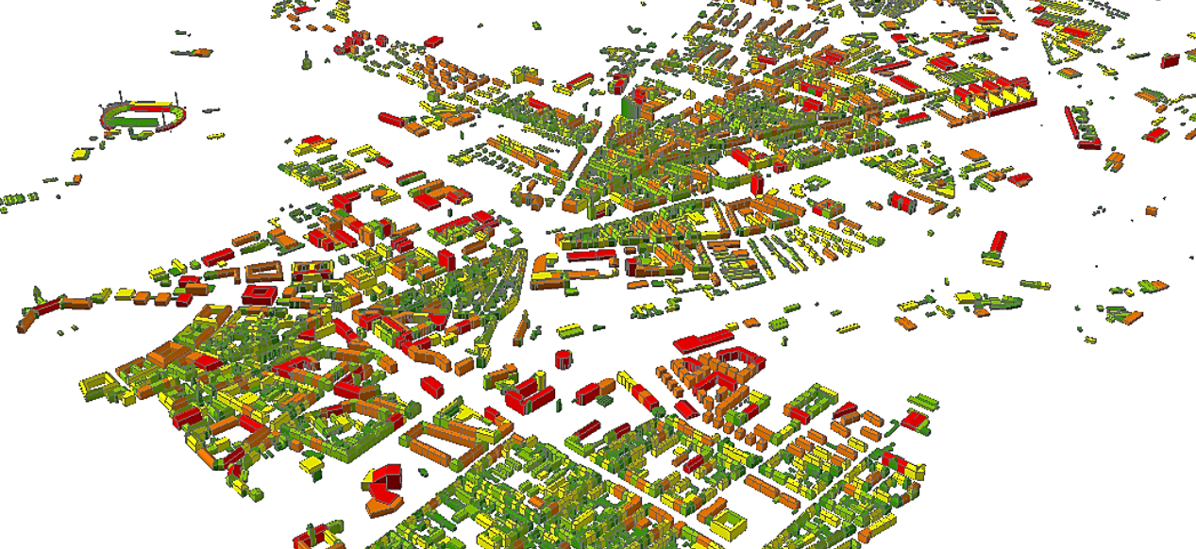
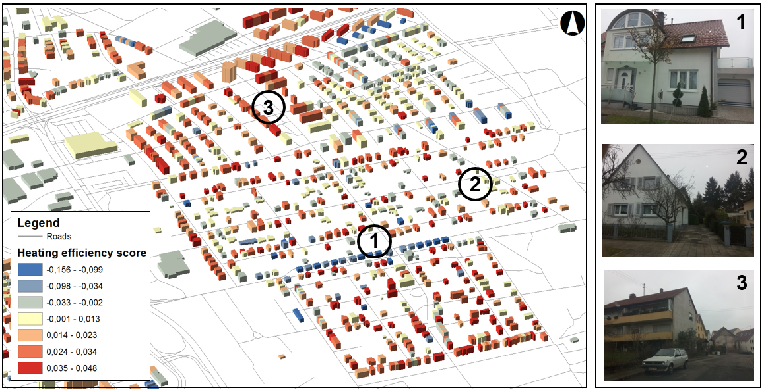
Visualization needs
Scale dependence
2D
Global systems modelling
State wide modelling
Regional modelling
(Bidah and Murshed 2016)
City modelling
District modelling
Building Simulation
3D
(Saed and Wendel 2015)
Notes:
Geospatial – Cartesian coordinate system

Slide 7
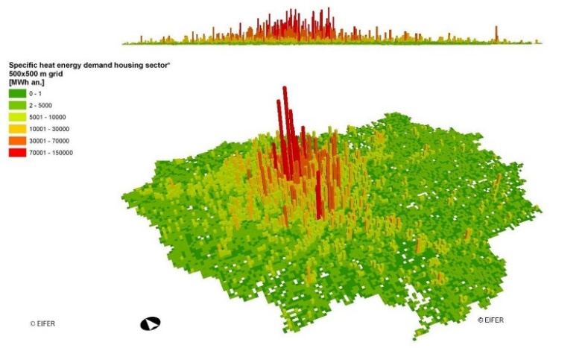
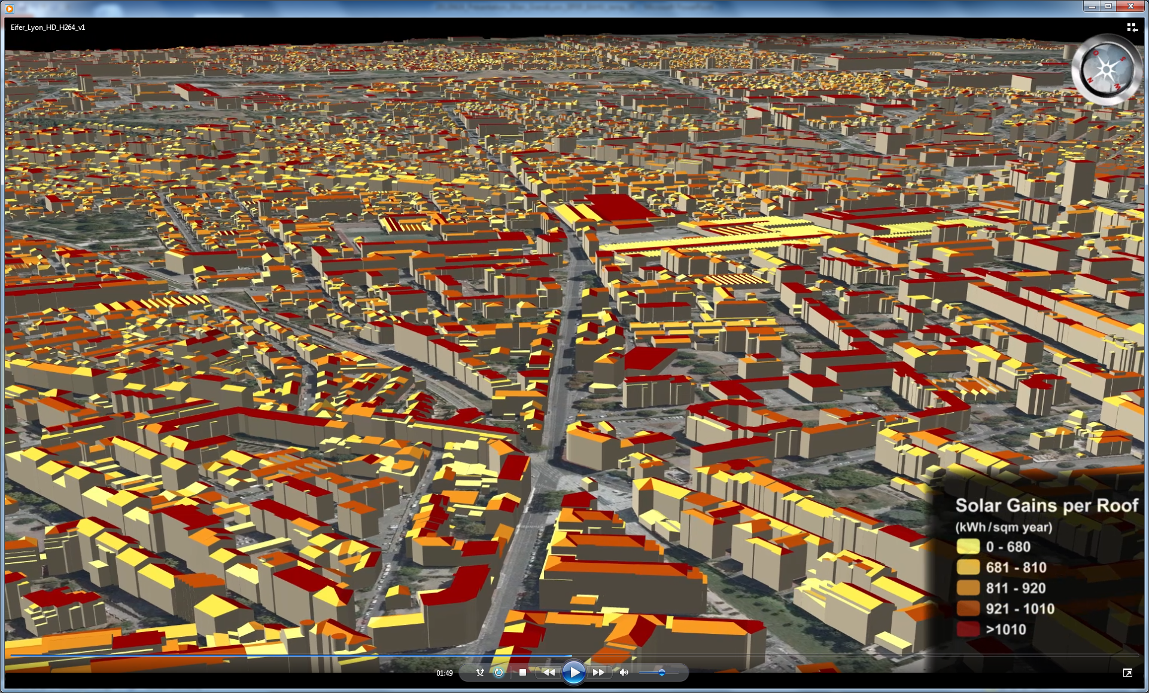
Visualization needs
Scale dependence
2D
Global systems modelling
Regional modelling
(Keim 2006)
City modelling
District modelling
Building Simulation
3D
(Bahu et al. 2012)
Notes:
Geospatial – Cartesian coordinate system

Slide 8
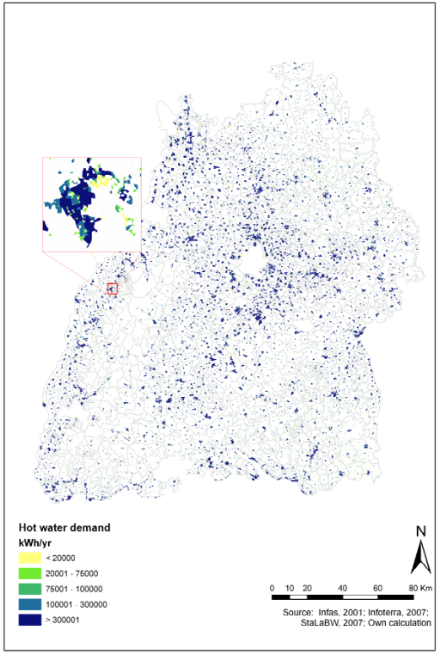
Visualization needs
Scale dependence
2D
Global systems modelling
Regional modelling
City modelling
District modelling
Building Simulation
3D
(Murshed 2009)
Notes:
Geospatial – Cartesian coordinate system

Slide 9
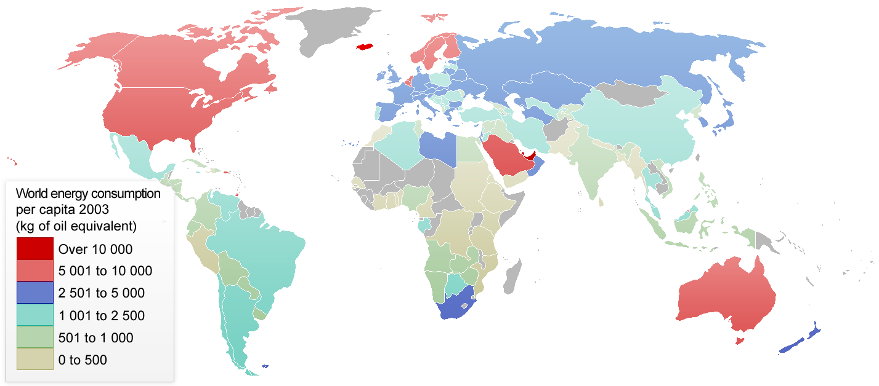
Visualization needs
2D
Global systems modelling
Scale dependence
Regional modelling
City modelling
(International Energy Agency, 2004)
District modelling
Building Simulation
3D
Notes:
Geospatial – Cartesian coordinate system

Slide 10
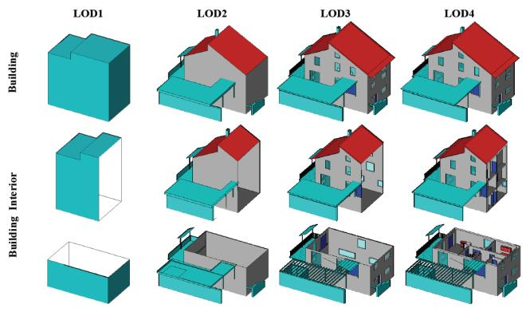
Requirements
Visualization at the urban scale
3D visualization of buildings
Storage of semantic building attributes at multiple LODs (i.e. CityGML)
Access to results of energy modelling outputs stored in a PostgreSQL
Open-source (OCG standards and guidelines)
Browser and platform independent and plug-in free (no client side installations)
Source : Gröger et al., (2012)

Slide 11
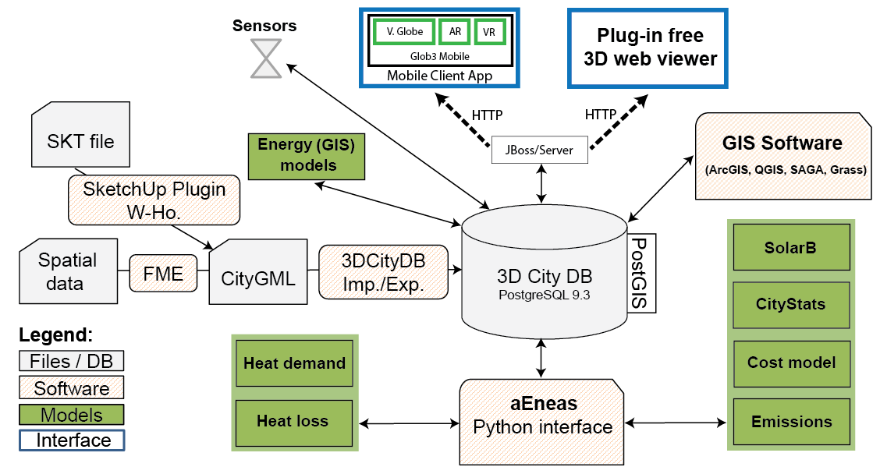
Requirements
Open-source data infrastructure
(Modified after Simons and Nichersu 2014)

Slide 12
Current status
Overview of the state of the art at the start of the project in 2014
Wide use of 3D browser plug-ins
Google Earth
Unity Web Engine
Virtual City Systems
Limited open-source 3D solutions
OSM Buildings, Open3DGlobe, Heidelberg 3D
Cesium.js was still in an early stage
Limited documentation on 3D visualization using open-source software
Limitations in WebGL standard adoption by web browsers
ESRI lacking in 3D

Slide 13
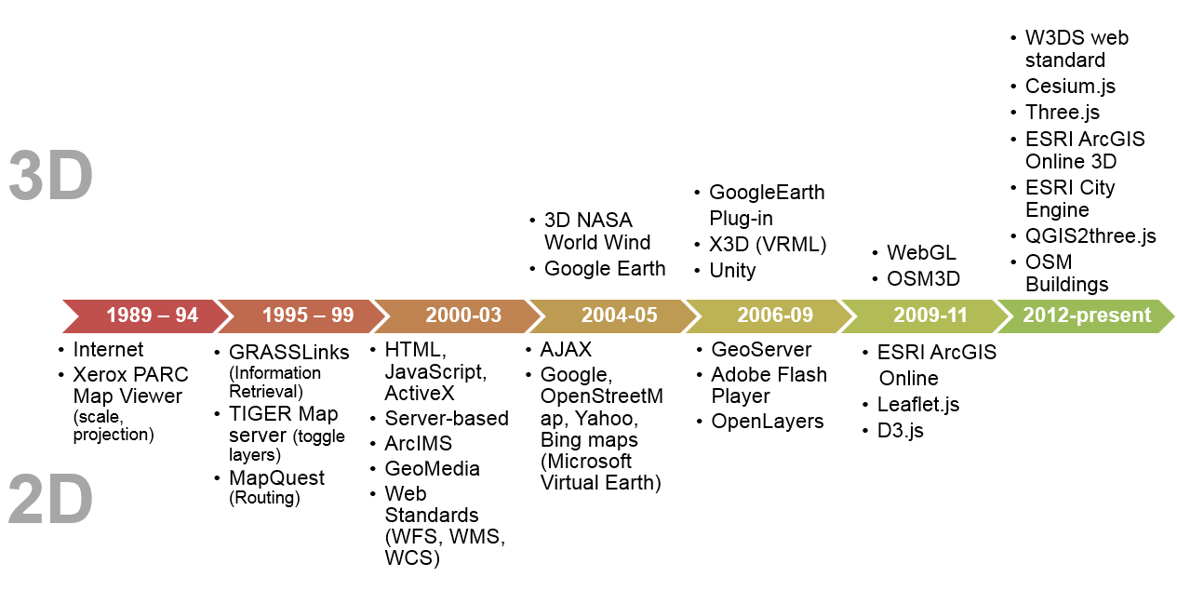

Current status
Evolution of Web Mapping
VRML
Flash
Shockwave
Notes:
1.generation
Xerox – first interactive map viewer
ESRI ArcIMS – Integr/aph GeoMedia
2. Generation
Html
Nasa - 2003
3. Generation
Ajax
Microsoft = bing maps = 2005
Google earth - 2008

Slide 14
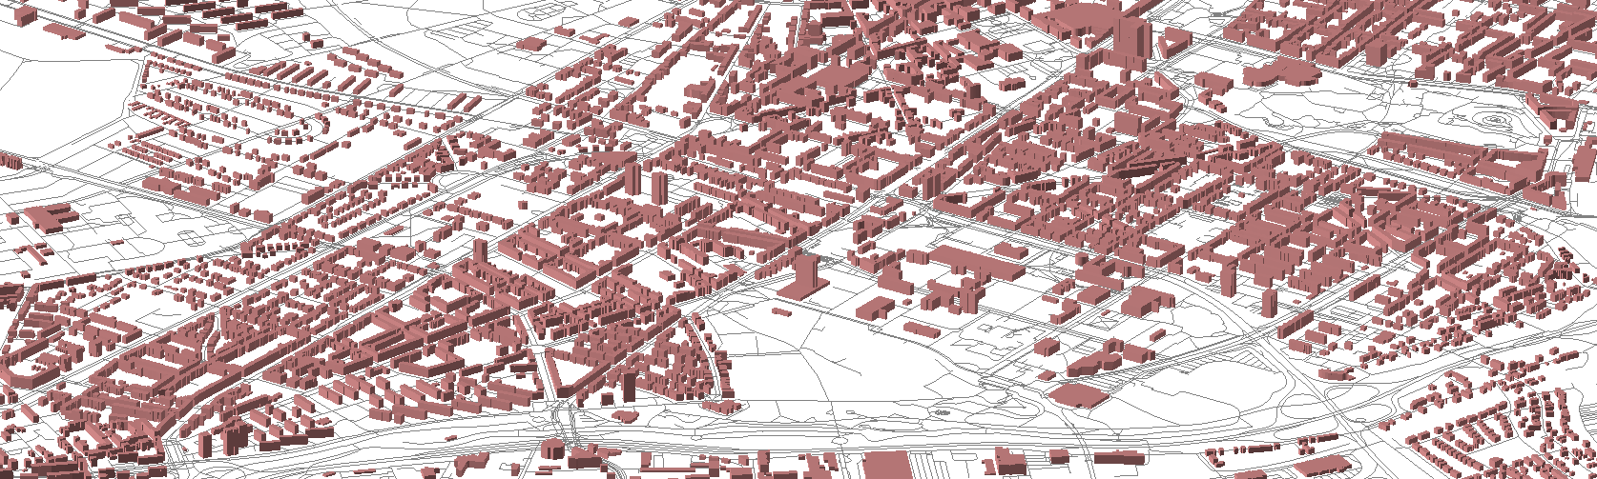
3D data set
Steps to generate the 3D city model for the city of Karlsruhe
OpenStreetMap (OSM)
Building footprints (Polygons)
Building types
Roads (Lines)
Natural features (Vegetation, Water - Polygons)
Custom generation
Height (Number of floors), SRTM data
Attributes (Socio-demographic (Census, INFAS) and energy model outputs)
CityGML LoD1 (total of 80k buildings)

Slide 15
Methodology
Technologies used
Programming Languages
HTML – Functional control of web page
JavaScript – Control of elements and data conversion
Python – Database and server connection
SQL – Database queries
JavaScript Libraries
ExtJs - Interactive web applications
Three.js - 3D visualization
D3.js - Conversion of geographic coordinates
d3-threeD.js - Link Three.js with D3.js
Data Formats
GeoJSON - Data transfer to WebGL
Scalable Vector Graphics (SVG)
Shapefile
CityGML
Notes:
Technologies
WebGL- 3D web standard
HTML - Functional control of web page
JavaScript - Control of elements and data conversion
Python - Database and server connection
Structured Query Language (SQL) - Data base queries
Data exchange format
GeoJSON - Data transfer to WebGL
Software libraries/APIs
EXT JS - Interactive web applications
Three.js - 3D visualization
D3.js - Conversion of geographic coordinates
D3-ThreeD.js Link Three.js with D3.js

Slide 16
Methodology
DB Infrastructure
Browser
(Interface)
Connection
Python
HTML
JavaScript
SQL
Notes:
PHP over Python
- Because currently @ EIFER energy simulation models are run using Python
- Easier to integrate

Slide 17
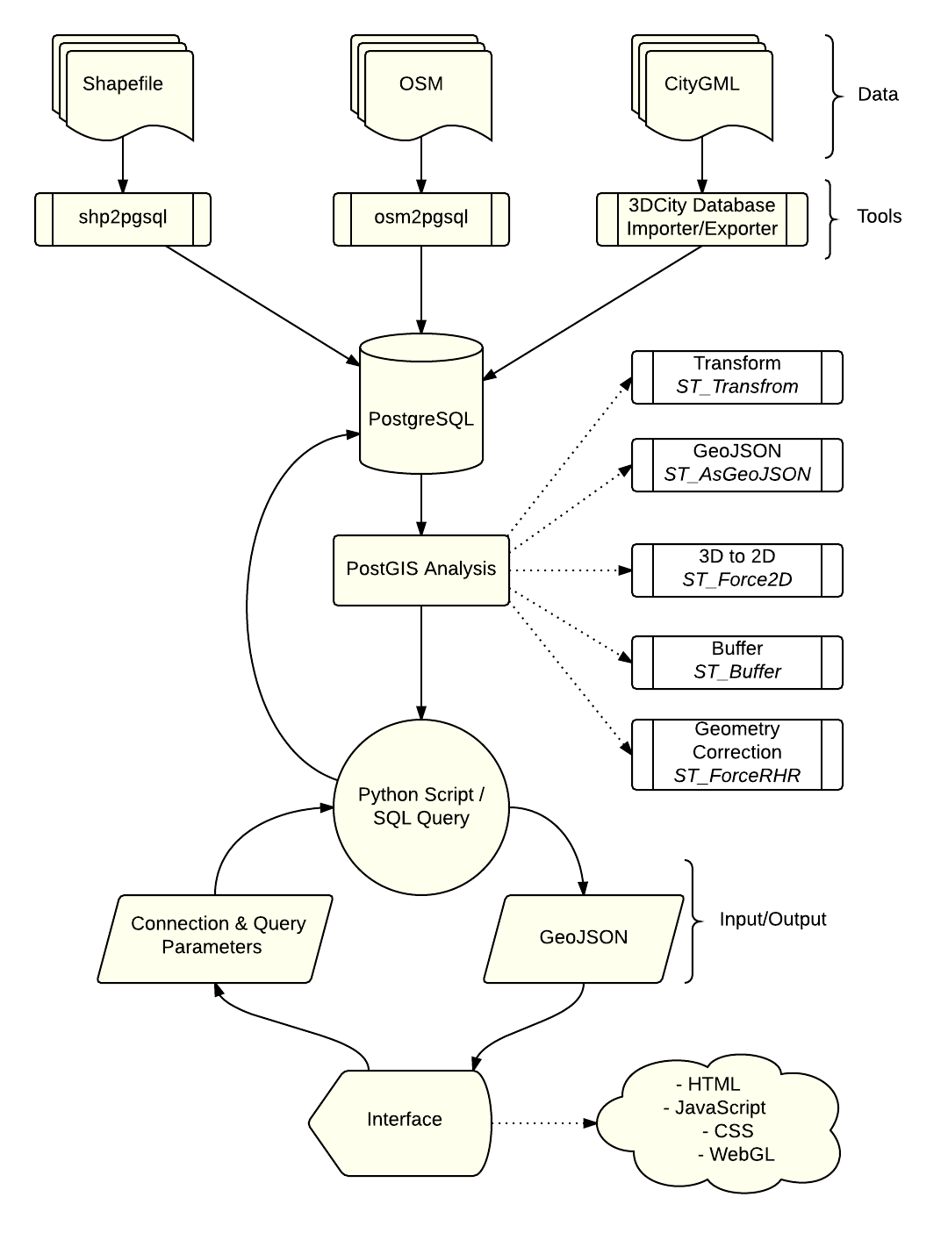
Methodology - Workflow
Data input
Data processing
Data transformation and visualization
Notes:
Data input
Data processing
Data transformation and visualization

Slide 18
Methodology – Dataflow
Polygons – Buildings & Natural features
GeoJSON
SVG
Footprint
{
"type": "FeatureCollection",
"features": [
{
"type": "Feature",
"properties": {‘osm_id’:1234},
"geometry": {
"type": "Polygon",
"coordinates": [ [
[0,0],
[1,0],
[1,1],
[0,1],
[0,0]
] ]
} }
]
}
<svg width="100" height="100">
<path d=" M 0 0
L 0 1
L 1 1
L 1 0
L 0 0" stroke="red"
stroke-width="2"
fill="none" />
</svg>
(0,1)
(1,1)
PostGIS
D3.js
(0,0)
(1,0)

Slide 19


Methodology – Dataflow
Polygons – Buildings & Natural features
SVG
Extruded 3D Object
<svg width="100" height="100">
<path d=" M 0 0
L 0 1
L 1 1
L 1 0
L 0 0" stroke="red"
stroke-width="2"
fill="none" />
</svg>
3D Object
d3-threeD.js
Three.js
(0,1)
(1,0)
(0,0)
$$Extrusion Value=Number of floors ×arbitrary value$$
$=Number of floors ×10$

Slide 20
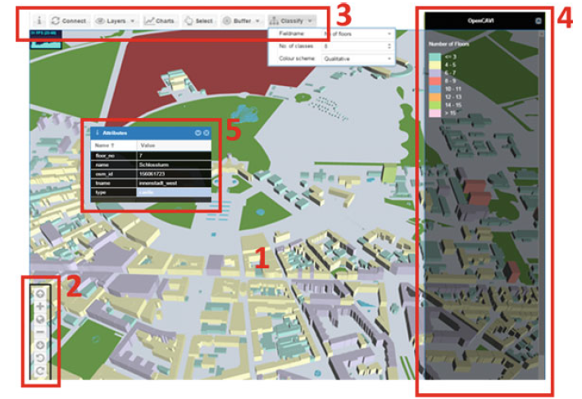
Visualization interface
3D web interface layout consists of:
Viewer window (1)
Navigation controls (2)
Toolbar (3)
Action panel (4)
Information windows (5)
Notes:
A 3D web interface layout consisting of Viewer window (1), Navigation controls (2),
Toolbar (3), Action panel (4), and Information windows (5)

Slide 21
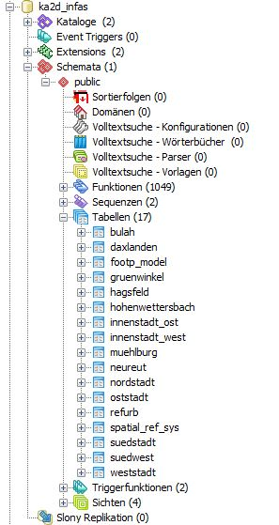
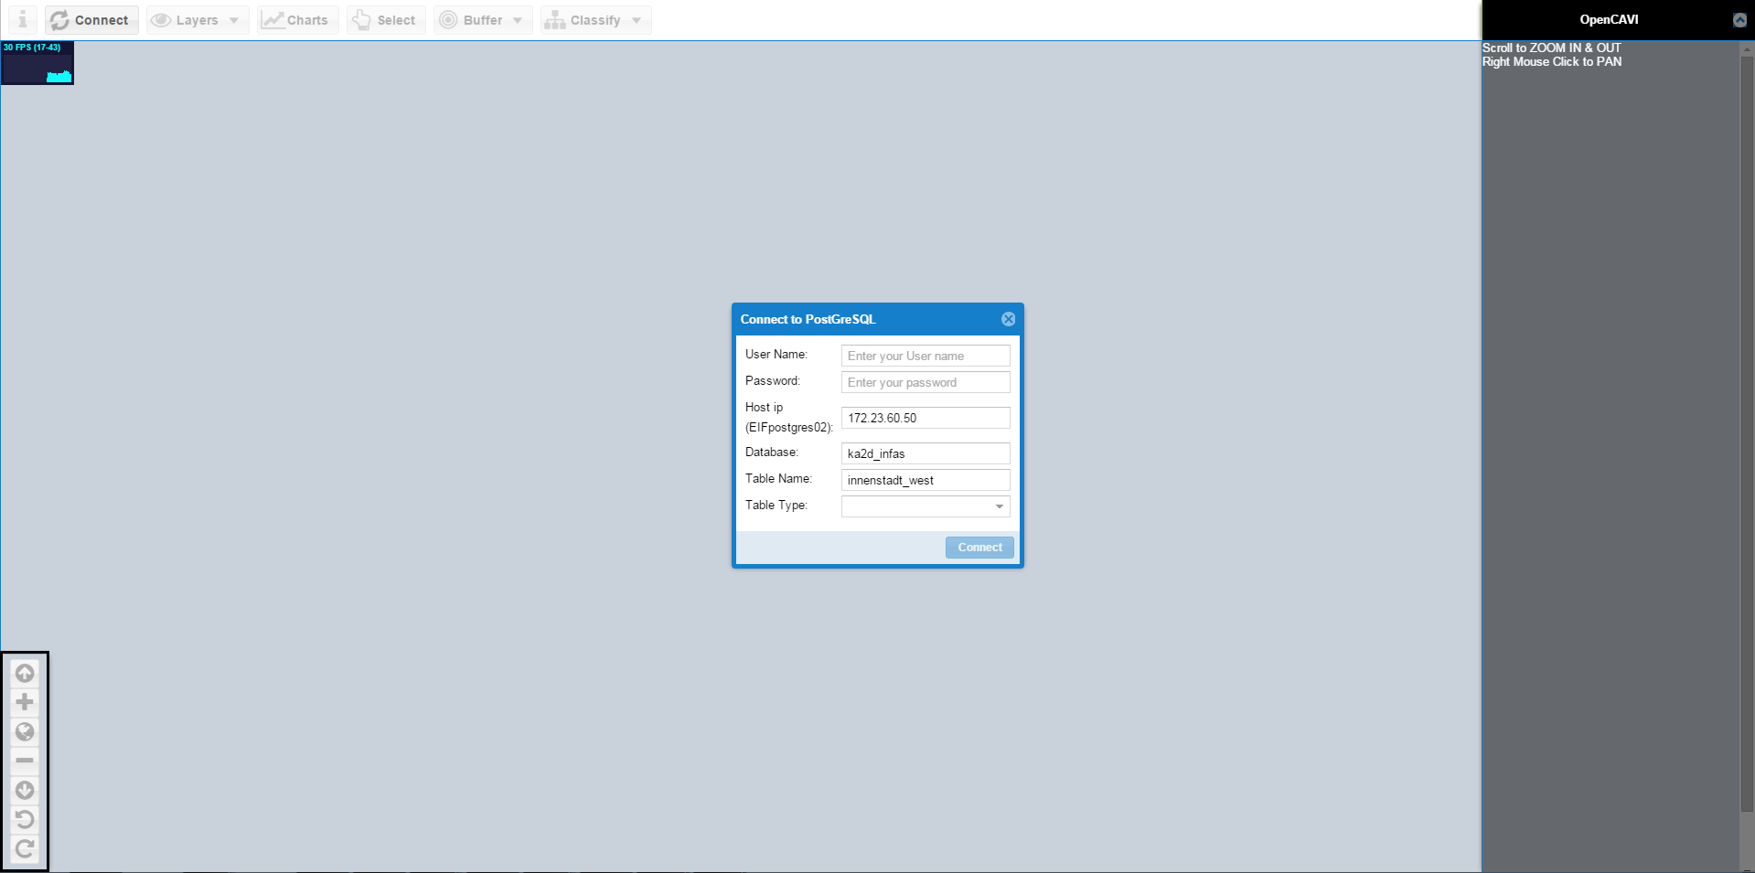
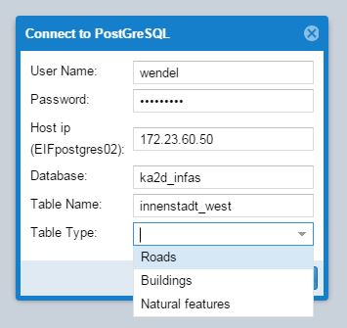
Visualization interface

Slide 22
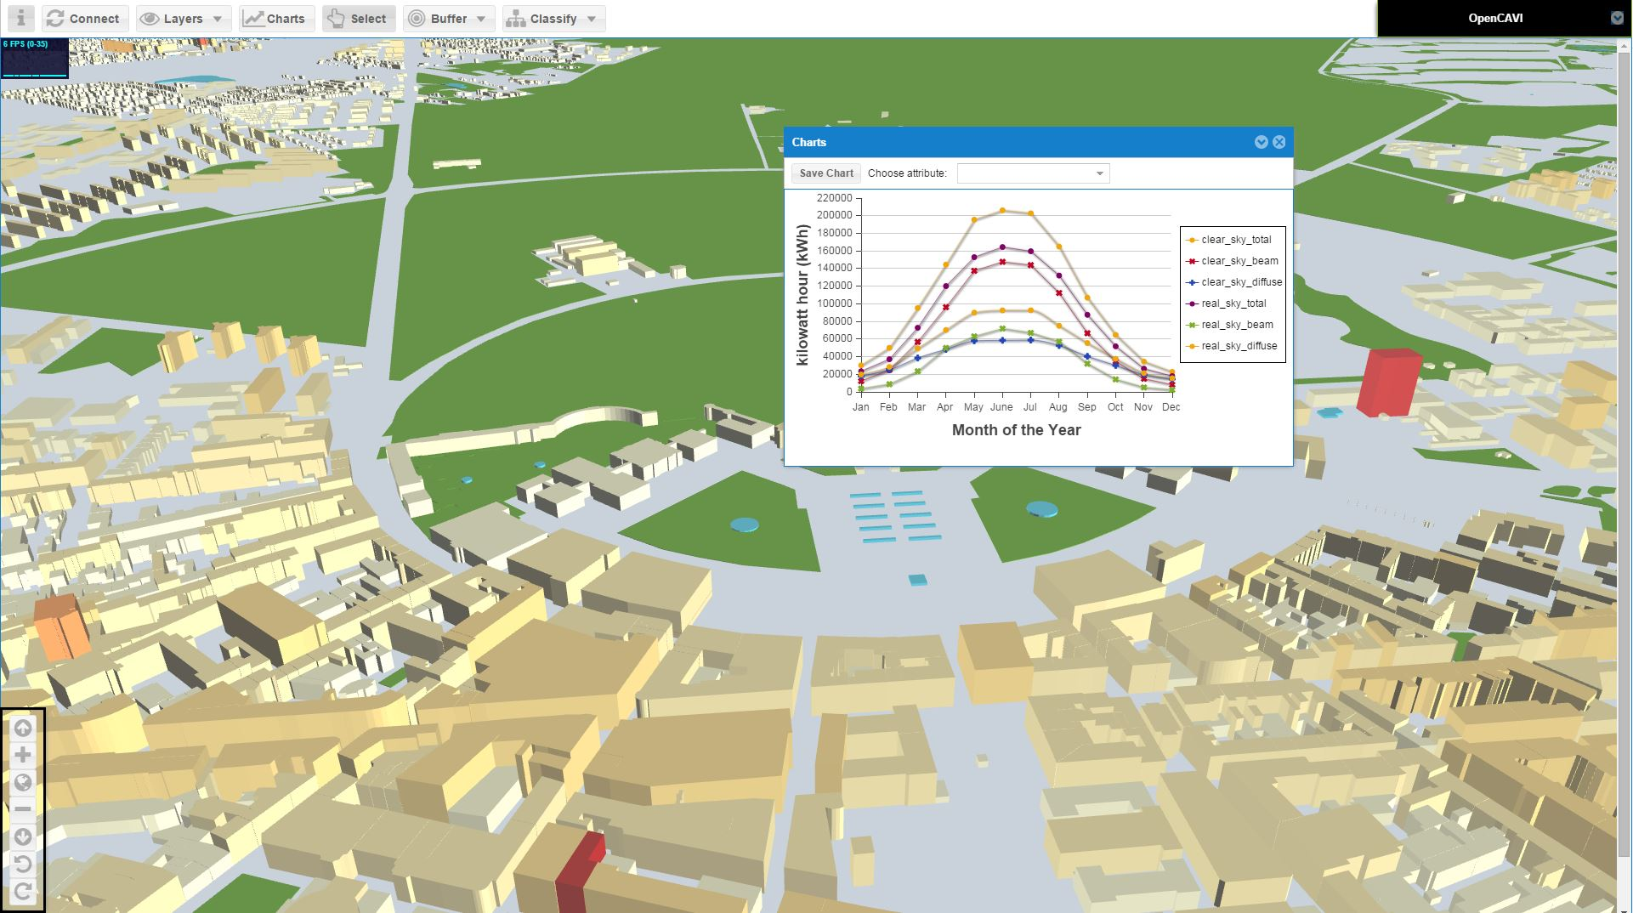
Visualization interface

Slide 23
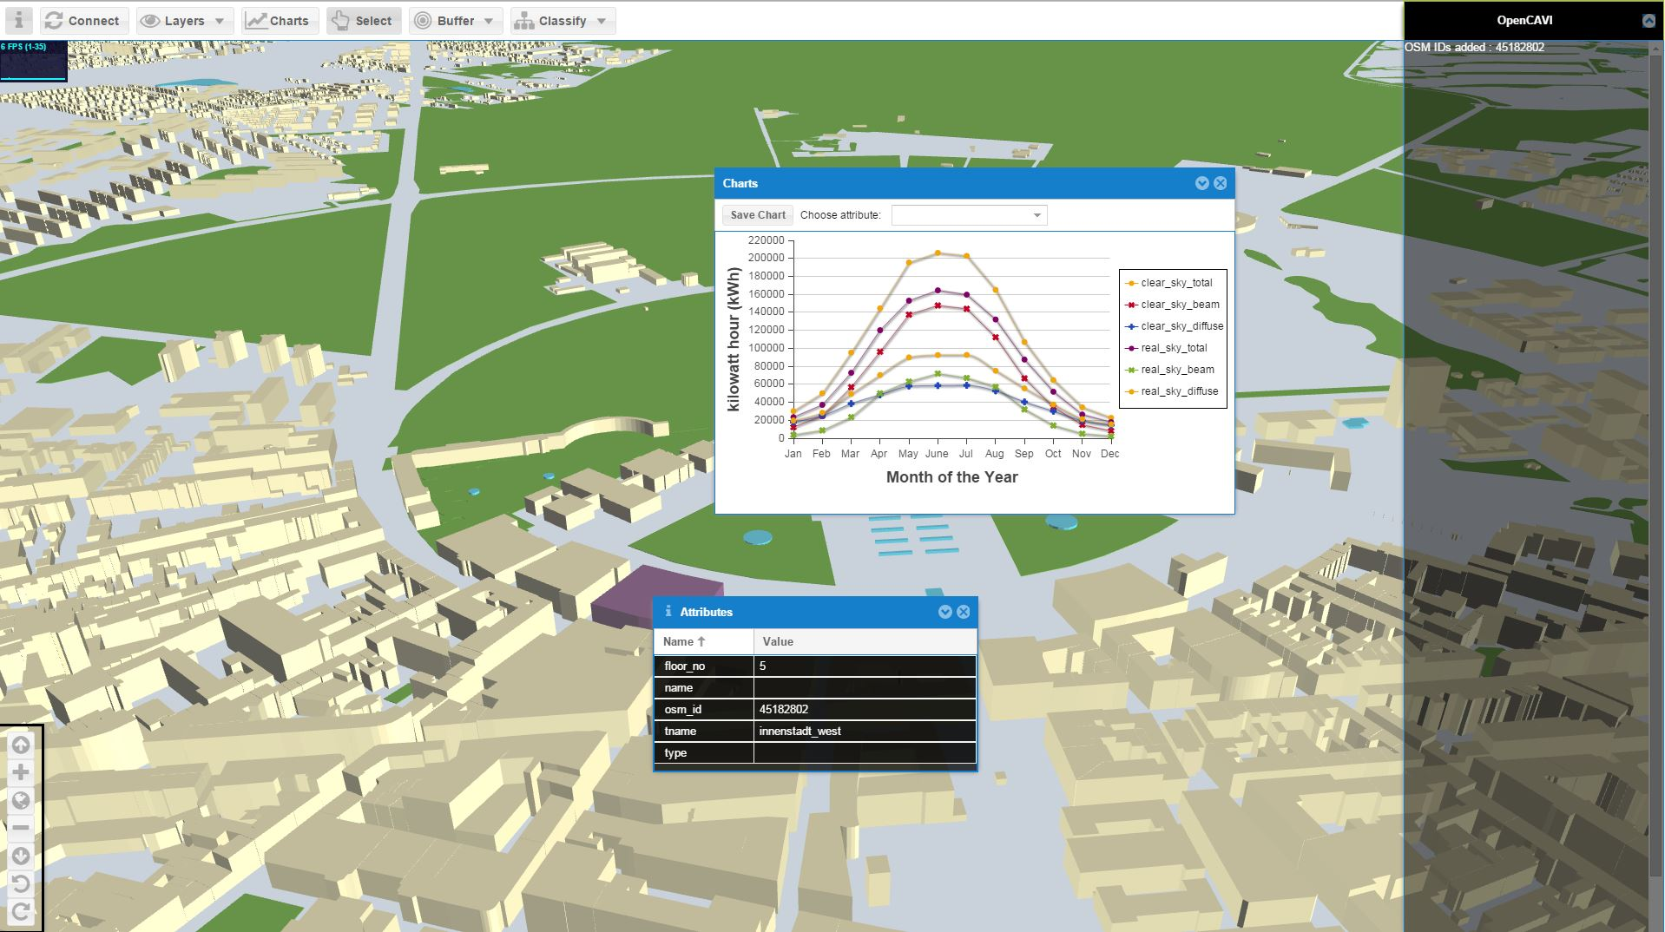
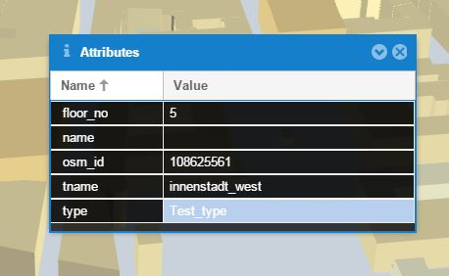
Visualization interface

Slide 24
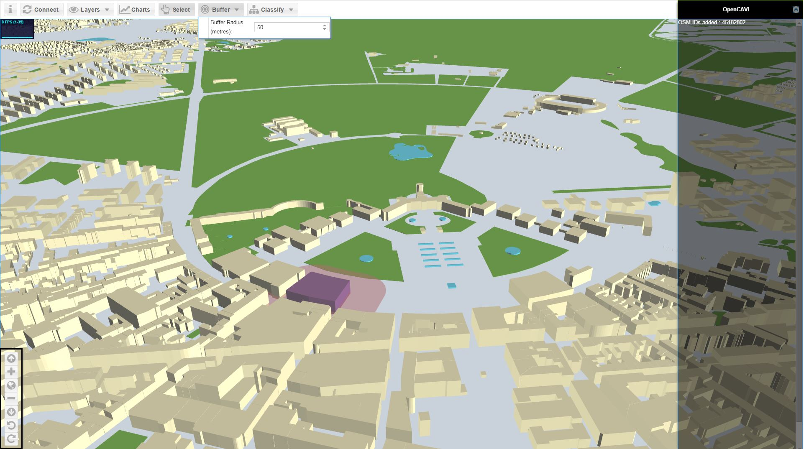
Visualization interface

Slide 25
Results
Performance benchmarking
 | ~1800 building objects |  | ~14000 building objects
Browser | Memory | FPS | Memory | FPS
Chrome | ~200 MB | 35-45 | ~400 MB | 7
Firefox | ~240 MB | 57-60 | ~940 MB | 3
Safari | ~273 MB | 25-40 | ~1.73 GB | 9-15
Internet Explorer | ~350 MB | 24-38 | ~960 MB | 6-10
Preferable : Lower Memory & Higher FPS (Frames per Second)
Tested on Intel i5, 8GB RAM, 128SSD, Intel HD Graphics
Notes:
Chrome – best
Firefox – poor with larger memory
Safari – good graphics but more RAM
Internet Explorer – comparatively better with memory management

Slide 26
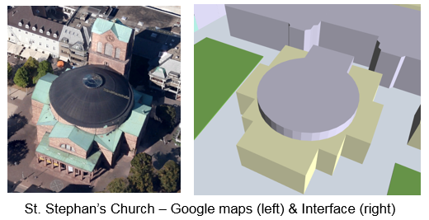
Conclusion (1)
PostgreSQL and PostGIS enables full control over customization and functionality from different sources
Proprietary plug-in based APIs are not the future
Limitations of current implementation:
Steep learning curve
Arbitrary selection of extrusion on origin values in
three.js and D3.js conversions
Limited cartographic visualization capabilities (own implementations)
Problems with textures
Current web3D limitations for spatial data
Data standardization
W3DS (OGC Web 3D Service)
Enhancement potential
WMS/WFS via Geosever for base layers

Slide 27
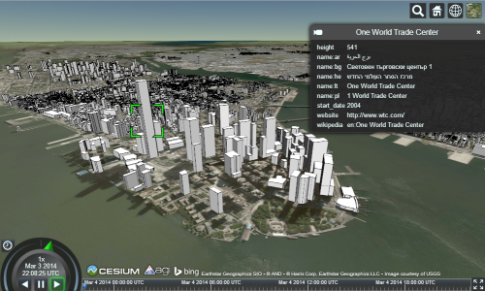
Conclusion (2)
Rapid advancement of 3D web technology
Most WebGL 3D applications are heavy on the client side
Streaming of data might be a solution (e.g. gaming industry)
WebGL standardization process (OGC)
3D Portrayal Service
Cesium.js has seen many possibilities (cartographic potential)
Mobile developments (e.g Globe3D)

Slide 28
Publication:
Wendel, J., Murshed, S.M., Sriramulu, A. & Nichersu, A. (2016). Development of a Web-Browser Based Interface for 3D Data - A Case Study of a Plug-in Free Approach for Visualizing Energy Modelling Results.In Progress in Cartography (pp.185-205). Springer International Publishing.
Contact:
Syed Monjur Murshed
European Institute for Energy Research
murshed@eifer.org
Thank you

